Slide 1
MODULE 4 – INTRODUCTION TO PERIPHERAL INTERFACING - I
Dr. P Nirmala
Assistant Professor, Sr. Gr. I,
SENSE,
VIT Chennai Campus.

Slide 2
Timer 8253

Slide 3
What is 8253/8254?
It is not possible to create a time delay using delay routines
Intel’s programmable timer 8253/8254 will generate an accurate time delay
While 8253/8254 are capable of taking care of the time delays and timing of the process, the microprocessor can be free from these tasks and perform other tasks
This reduces the software overhead on the microprocessor

Slide 4
Characteristic features of 8253
Has three counters each with maximum count rate of 2.6 MHz.
Thus, it is possible to maintain 3 separate delays or maintain 3 independent counters simultaneously
8253 communicates with the microprocessor’s bus using D0 to D7 bidirectional data buffer

Slide 5
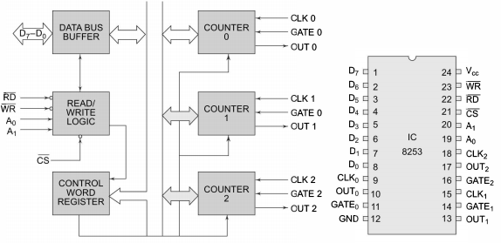
Block and pin diagrams

Slide 6
continued
The three counters are independent of each other but are similar in organization
They are 16 bit counters that can operate either in BCD or Hexadecimal mode
The mode control word register contains the information that is used for writing or reading count value into or from the respective count registers using OUT and IN instructions.
The control word can only be written and cannot be read
When CS’ is low, it enables the Timer 8253

Slide 7
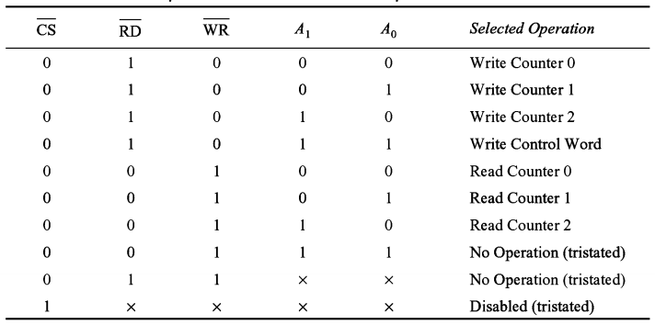
Various control inputs

Slide 8
Control word register
A control word must be written in the respective control register by the microprocessor to initialize the 8253.
Depending upon the control word decided by the user, the counter works independently.
Only after the data is put on the data bus and a falling edge appears in the clock signal of the peripheral device, the count can be written to the counter

Slide 9
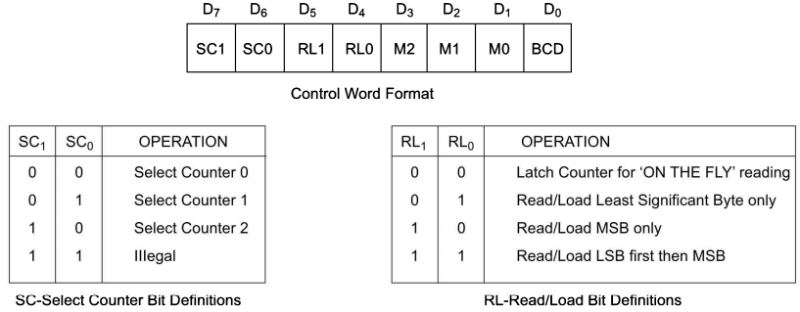
continued

Slide 10
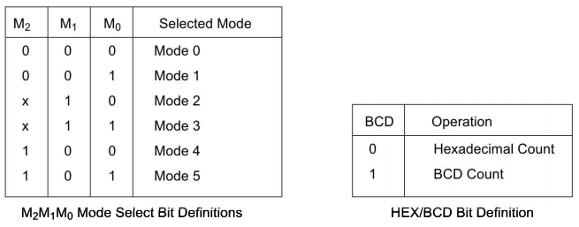
continued

Slide 11
Mode 0 – interrupt or terminal count
Output is initially low after the mode is set
Output remains low even if the count value is loaded in the counter
The counter starts decrementing the count after the falling edge of the clock, if the GATE input is high
At each falling edge, the counter decrements till the count becomes 0
Once count becomes 0, the output goes high and remains high until the selected control word register or the count register is loaded with a new mode or count respectively
The high output can be used to interrupt the processor whenever required by setting a suitable count

Slide 12
continued
When the count register is filled with a new count value while the previous count is executing, then the following sequence of operations occur.
The first byte of the new count stops the previous count.
The second byte, when written, starts the new count by terminating the previous count
For normal counting, the GATE signal should be active high.
When GATE goes low, the counting is terminated and the current count is latched until the GATE goes high again.

Slide 13
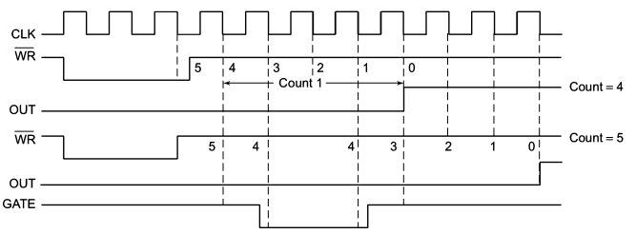
continued

Slide 14
Mode 1 – programmable one shot mode
In this mode, 8253 can be used as a monostable multivibrator
The duration of the quasistable state of the multivibrator is defined by the count value in the count register.
The GATE input is used as trigger input in Mode 1.
The output remains high till a suitable count is loaded in the count register and a trigger is applied
After the trigger is applied, the output goes low and remains low till the count becomes 0.
When a new count value is filled in the count register when a previous count is going on, it doesnot affect the count until there is a trigger given by the GATE
The new count starts after the new trigger pulse

Slide 15
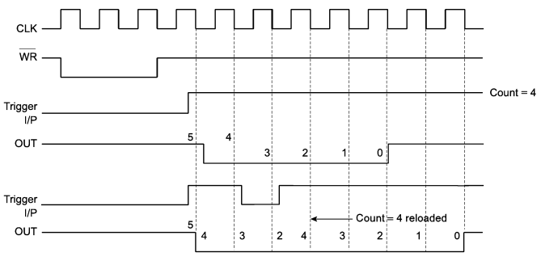
continued

Slide 16
Mode 2 – rate generator or divide-by-n counter
If N is loaded as the count value, then after N-1 cycles, the output becomes low only for one cycle
The count N is reloaded and again the output becomes high and remains for another N-1 cycles
The output is normally high after initialization
A low on the GATE signal can also force the output to be high
If the GATE goes high, the counter starts counting from the initial value

Slide 17
continued
The count down starts and whenever the count becomes zero, another active low pulse is generated at the output.
They last for one clock cycle
The number of input clock pulses between the two active low pulses is equal to the count value

Slide 18
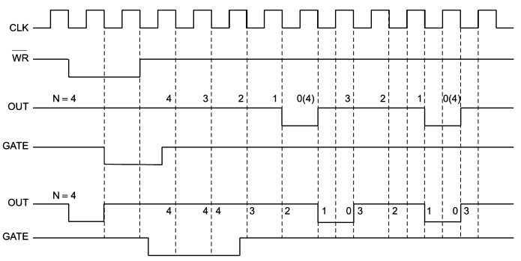
continued

Slide 19
Mode 3 – square wave generator
When the count N is even then for half of the count the count is high and for the rest half the count is low.
If the count is odd, the first clock pulse decrements it by 1, making it even
Then the output goes high for the first half of the count and goes low for the remaining half, thus generating a square wave.
In case of odd count the output is high for a longer duration and low for a shorter duration
If the loaded count value N is odd, then the output is high for (N+1)/2 cycles and low for (N-1)/2 cycles.

Slide 20
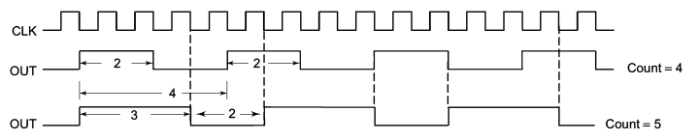
continued

Slide 21
Mode 4 – Software triggered strobe
Once the mode is set, the output goes high
When count is loaded, the count starts.
When count becomes 0, the output goes low for one cycle and then becomes high again
This low pulse can be used as a strobe, while interfacing the microprocessor with other peripheral devices.
When the GATE goes low, the count is latched
If a new count is loaded in the count register when the previous count is in progress, then the new count is accepted after one clock cycle.

Slide 22
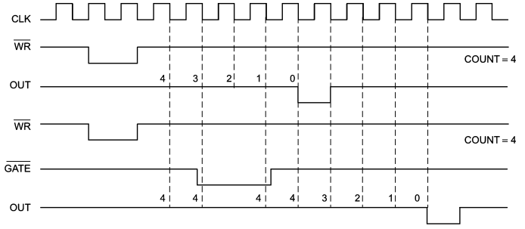
Mode 4

Slide 23
Mode 5 – to generate a delayed strobe
When there is a rising edge at the trigger input, a strobe is created
Once the mode is set and the count is given, the output goes high
The counter starts counter after the rising edge of the trigger input
When the count becomes 0, then the output becomes low for one clock cycle.

Slide 24
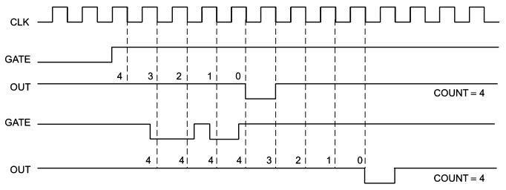
Mode 5

Slide 25
weblinks
https://nptel.ac.in/courses/108/107/108107029/
https://nptel.ac.in/content/storage2/courses/108105057/Pdf/Lesson-14.pdf

